Slide 1
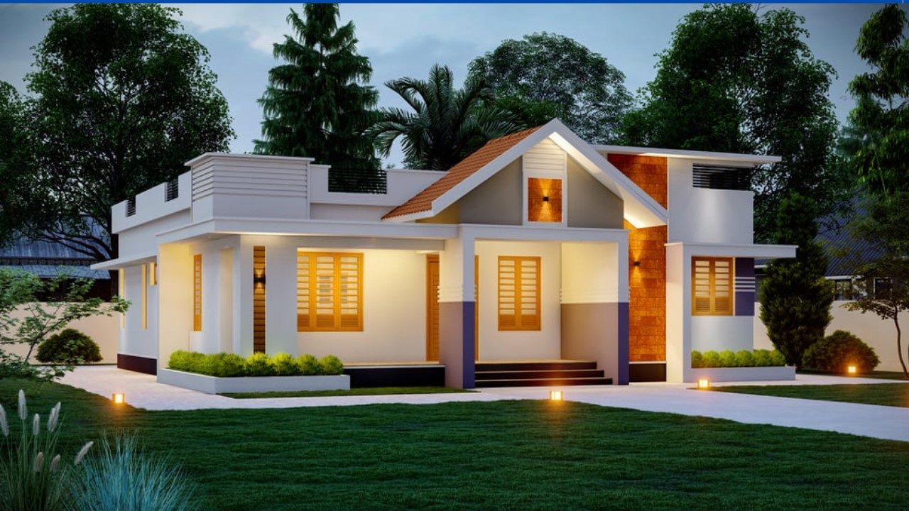

A2 level 05 Week 03
Saturday’s Speaking Session
Topic of the Session:
Dream House
Open your Imagination

Slide 2


PART 1: Warm up YOUR tongue
“Try to perform the following dialogues with your teacher.
Correct your pronunciation mistakes along the way.”
This exercise corrects your pronunciation and improves your reading skills

Slide 3
Dialogue (Ahmed & The teacher)
(Teacher): Hi good morning, (Student’s name). How are you?
Ahmed (Student): Hi good morning, teacher. I am fine. Thank you. And you?
(Teacher): I am fine, too. Thanks. Please, tell me, (student’s name) ... Where do you live currently?
Ahmed (Student): Now, I live in a small apartment on the 5th floor with some noisy neighbors.
(Teacher): You don’t seem to get along very well with your neighbors, do you?
Ahmed (Student): No. We don’t get along very well. They are very noisy and they don’t respect our sleeping time.
(Teacher): I see ... But is that the only reason that made you look for a new house?
Ahmed (Student): No. Not the only reason of course.
Any pronunciation error is corrected by the teacher instantly!

Slide 4
Dialogue (Ahmed & The teacher)
Ahmed (Student): When you live in an apartment, you have to come back early in the evening or you will not find any parking space around.
(Teacher): Yeah .. That’s an issue that keeps stressful all the time.
Ahmed (Student): Also, when you live on the 5th floor, you always pray that the elevator is working. Because when it breaks, you will have to take the stairs carrying your heavy stuff!
(Teacher): Ok .. Now, tell me, please .. what kind of a house you’re looking for?
Ahmed (Student): I want a medium-size house in the city with at least two floors and a basement plus a garage where I can park my car any time I want.
(Teacher): Great! I hope you will find the house you’re looking for, soon. Thanks for your time.
Ahmed (Student): You’re always welcome, teacher. It’s my pleasure.
Any pronunciation error is corrected by the teacher instantly!

Slide 5

PART 2: Practical review
“Get back to Mounir’s and Ahmed’s conversations with the teacher and try to answer the following questions.”
This exercise helps you to member the vocabulary you learnt during the week

Slide 6
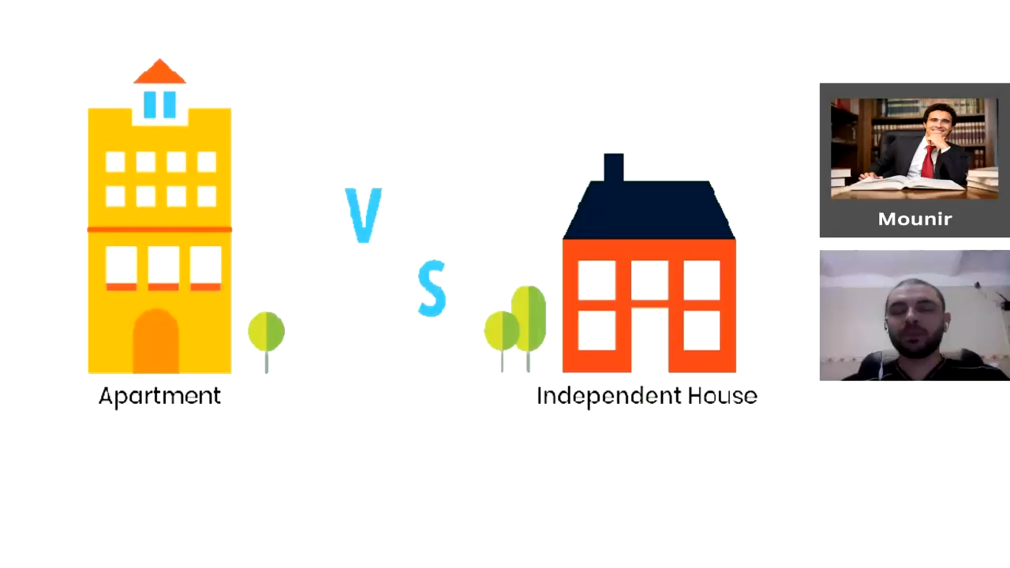
Mounir’s conversation
Re-watch the full conversations to be able to do this activity!

Slide 7
Possible questions
Where does Mounir live?
Does he own it? Or he just rents?
Can Mounir afford to buy a new house?
Is he married to a housewife?
Does she have time to manage a big house?
Is that the only reason why he prefers to live in an apartment?
What are the others reasons? (name at least 2)
What issues usually come with living in an apartment? (mention at least 2)
Does Mounir get along very well with his neighbors?
On which floor does he live?
Are the roofs and the walls soundproof?
What can you say about Mounir’s personality in general?
Re-watch the full conversations to be able to do this activity!

Slide 8
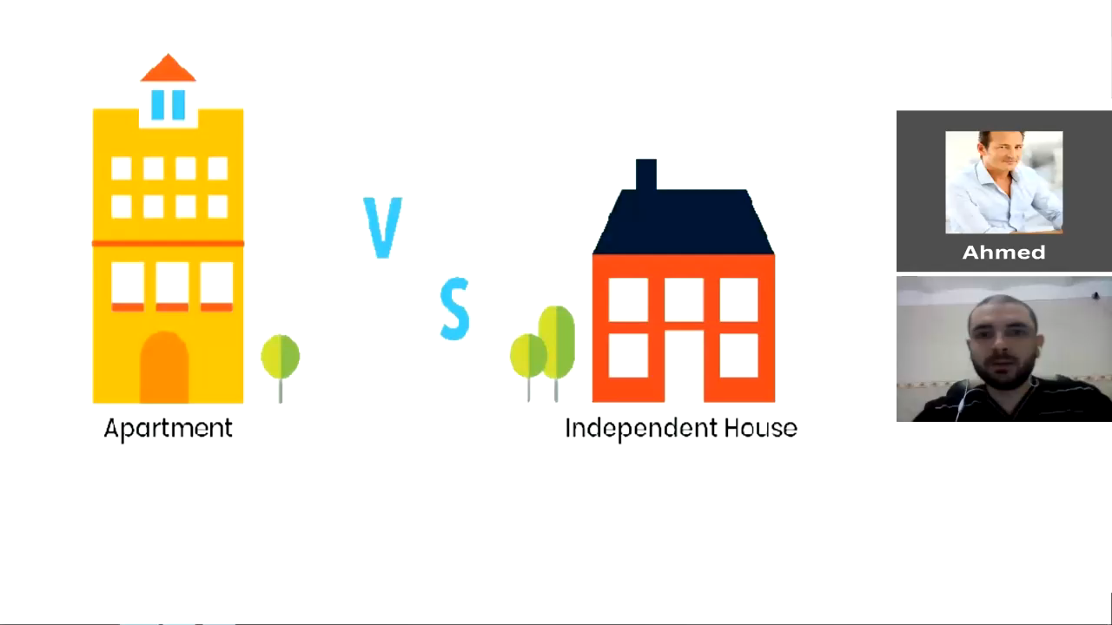
Ahmed’s conversation
Re-watch the full conversations to be able to do this activity!

Slide 9
Possible questions
Where does Ahmed live currently?
Does he like there?
On which floor does he live?
Does Ahmed get along very well with his neighbors?
If not, why?
Does Ahmd always have a parking issue? If not always, when?
Does the building elevator break occasionally?
How does he reach up to his apartment when it breaks?
Is Ahmed planning to stay there?
If not, where is he planning to move?
Can you describe Ahmed’s dream house briefly?
Re-watch the full conversations to be able to do this activity!

Slide 10

PART 3: Direct Conversation
Open your imagination to create your PERFECT HOUSE...
Do you prefer to have your house in a city or outside the city?
How many floors do you need in your house?
Do you prefer to have the kitchen on the main floor or the second floor?
How about the other rooms? What rooms do you prefer to have in each floor?
5. On which floor do you prefer to have your own bedroom?
6. Would you prefer to have a basement in your dream house?
7. Do you need a garage OR you prefer to park your car in a carport instead?
8. How a pool? Is it part of your plan?
9. Is there anything else you want to add to your dream house?
It’s time to SPEAK freely without fear or hesitation ... You are READY!

Slide 11

PART 4: Homework (oQ)
Task of the week: Read the following question and answer based on your own opinion. (short answers aren’t accepted!!!)
OQ: If you could choose ... Would you choose to lie in an apartment or in a big house? And why?
Explain and justify your answer!
This homework is to do your research and learn new vocabulary in the process

Slide 12
IMPORTANT NOTES
Choosing between an apartment and a big house depends on lifestyle and priorities. Apartments are often more affordable and located in urban areas, offering convenience and proximity to work, shops, and entertainment. They also require less maintenance and often include shared amenities like gyms or pools, making them ideal for a low-maintenance lifestyle. Security is usually better in apartments, with features like gated access or surveillance.
On the other hand, big houses provide more space, privacy, and the freedom to customize. They are perfect for families, pet owners, or those who enjoy gardening or outdoor activities. While houses are more expensive and require more upkeep, they offer long-term value and a sense of independence.
Personally, I would choose an apartment for its convenience, affordability, and urban location. However, the decision ultimately depends on individual needs and preferences.
Any pronunciation error is corrected by the teacher instantly!

